Slide 1
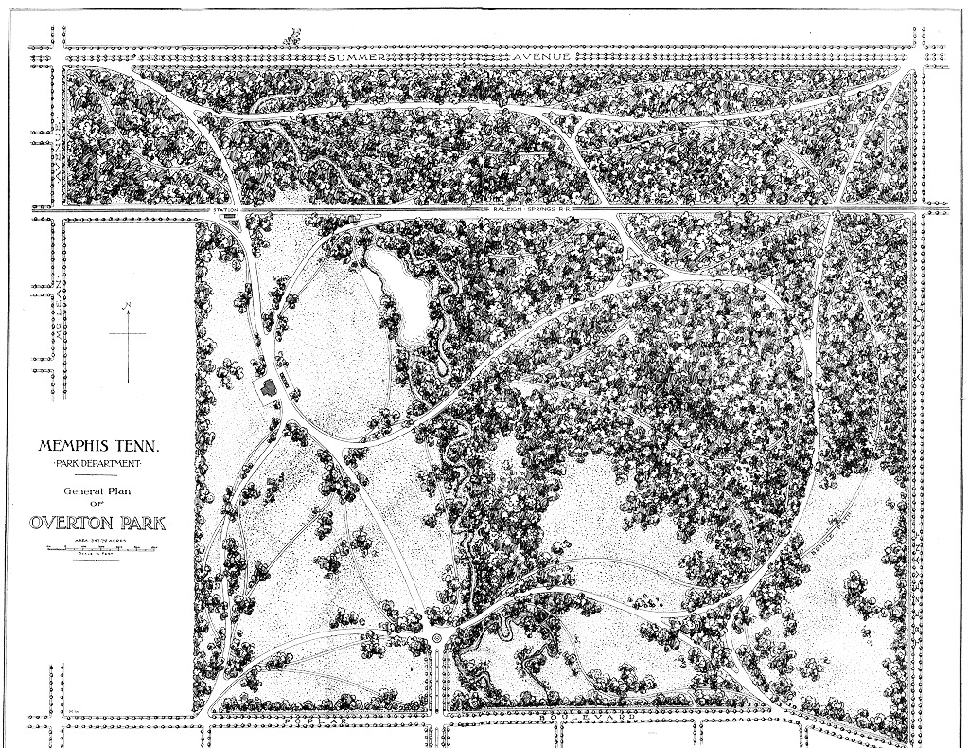
Exploring an alternative in habitat analyses: resource utilization functions
Malle Carrasco-Harris
PhD Candidate
Biological Sciences
Notes:
c. 1901
Previously, talked about home ranges copperheads Overton park
Also intro to genetics last spring
This semester: looking at habitat aspects in my copperhead population

Slide 2
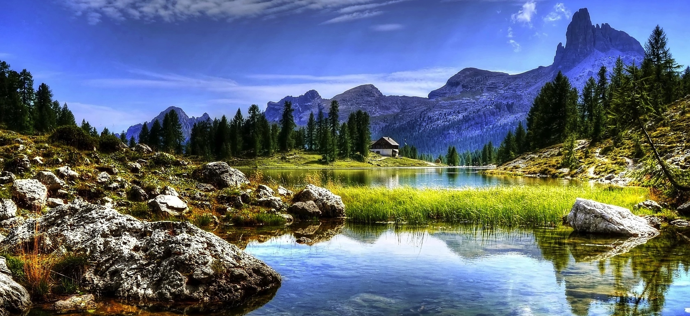
Pexels.com
Notes:
Consider this habitat at several different scales (landscape, microhabitat)

Slide 3
Big Question
Why do animals use the spaces they do?
Pexels.com

Slide 4
Resource Selection Studies
Pexels.com
Notes:
Today we will talk about why habitat studies are important to characterize an animal’s home range.
The methodology to do that
And how I accomplished that in my work.

Slide 5
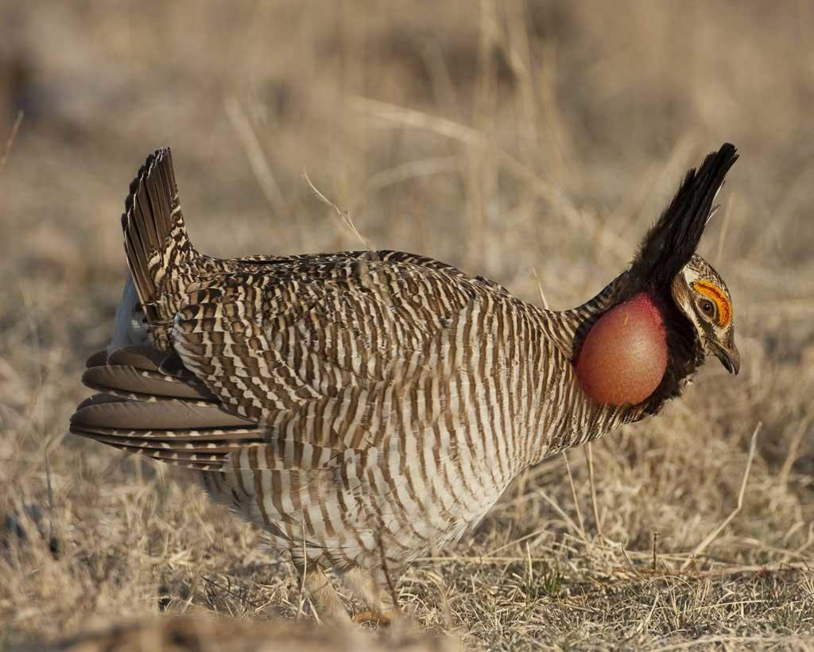
Resource selection analyses are crucial in wildlife conservation research.
Insight into habitat use across scales
Predict the success of a species as environments change
Provide land managers models
(Lautenbach et al. 2017)
Notes:
﻿Lesser Prairie-Chicken – population is vulnerable and decreasing; depends on grassland habitats as other grouse species do. Biggest threat is conversion of natural prairie to farmlands. Closer to where I’m from in TX, bits of OK and southwestern KS.

Slide 6
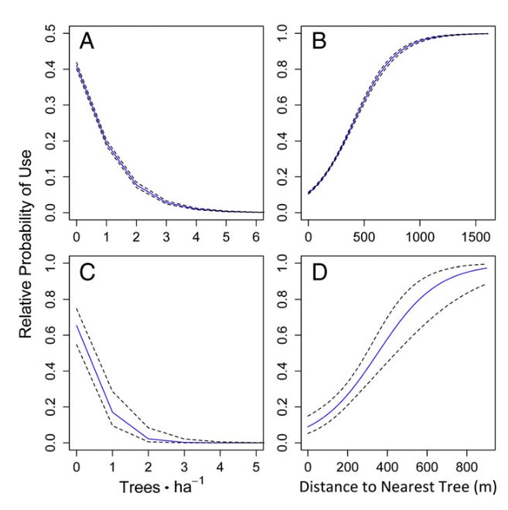
Resource selection analyses are crucial in wildlife conservation research.
Insight into habitat use across scales
Predict the success of a species as environments change
Provide land managers models
(Lautenbach et al. 2017)
Notes:
﻿Figure 3. Relative probability of female lesser prairie-chickens’ use (95% CI) in relation to distance to the nearest tree (m; A). Relative probability of female lesser prairie-chicken habitat use (95% CI) in relation to distance to tree density (trees ∙ ha−1) at the 16-ha scale (B), probability of nest site (95% CI) in relation to distance to the nearest tree (m; C), and relative probability of female lesser prairie-chicken nest site selection (95% CI) in relation to tree densities (trees ∙ ha−1) at the 36-ha scale (D) in Kiowa and Comanche counties, Kansas, 2013−2014

Slide 7
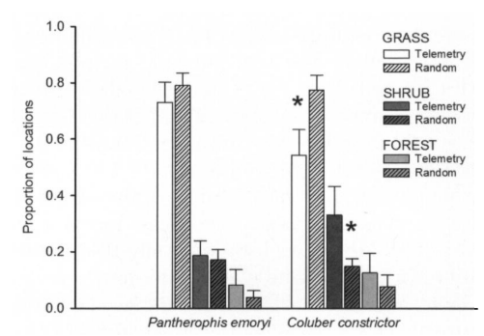
Methodology for habitat analyses
Resource Selection Function (RSF)
Considerations
Use vs. Availability
Random point generation
Selection vs avoidance assumption
Availability - Habit access assumption
Unit of replication
Tracked locations independent assumptions
Temporal autocorrelation of use points, not random points.
(Klug et al., 2011)
Notes:
RSF:
Many random points have to be generated – data collection is less intense when data is collected using remote sensing, but collecting random data at the microhabitat variable costs time and sample size of desired points. What are the boundaries for random point generation? For remote sensing data collection, this random point generation may be realistic, but for microhabitat data it can prove a hindrance– less animals/study selection and inability to know boundaries beforehand.
If resource use is selective, resources are used disproportionately to their availability. Preference usually inferred: preference for a particular resource reflects the likelihood of that resource being chosen if offered on an equal basis with others; therefore, it is nearly impossible to determine resource preference for free ranging animals because resources are never randomly available in equal units. (Marzlyff et all 2001) Furthermore, Usage depends on the investigator’s notion of what components are available to the animal (Johnson 1980). Absolute statements about preference or avoidance should be guarded against… Relative statements are possible because their nature invokes the concept of selection order. A component vital to the consumer may be so vital that the consumer need only use small amounts of it to satisfy its requirements, thus, usage is less than availability but a conclusion that the component is of little value may not be warranted. All of these issues stem back to the central problem of “how do animals perceive their world?” Do animals consider available as recent locations? Or is their memory involved over long periods of time and they can decide what to use when? How do animals define available for different resources?
Assumes that habitat can be accessed equally, may be unrealistic if there are physical, social, or other biological limiting factors. Social hierarchies may limit animals from using a space (and often the animal is viewed of as independent of others)
Frequently (but less so now) animal is not considered unit of replication but relocation is. Now, more models are considering animal as unit of replication, which avoids pseudoreplication.(Hurlbert, 1984; Otis & White, 1999). However, covariance structures are still incorrect if a model includes a random error effect for correlated points within-subject but not for randomly generated points, which are not correlated.
Models must account for temporal autocorrelation. Selecting a model that has a constant covariance structure, implying independence, would be inappropriate and may increase the frequency of Type I error rates (Zuur, Ieno, Walker, Saveliev, & Smith, 2009)

Slide 8
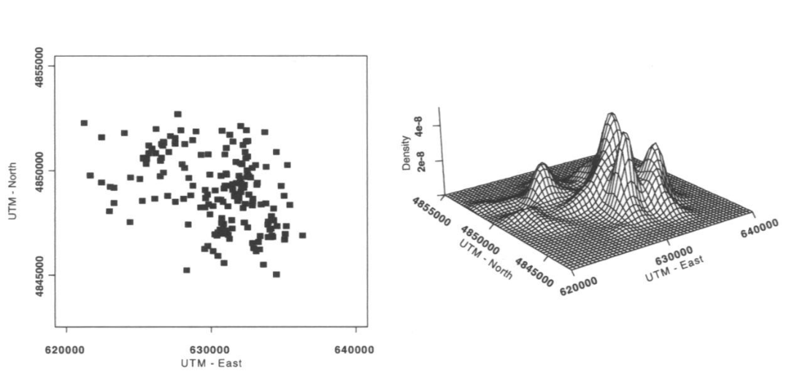
Methodology for habitat analyses
Resource Selection Function (RSF)
Resource Utilization Function (RUF)
Use vs. Availability
Quantify Use
(Klug et al., 2011)
(Millspaugh et al., 2006)

Slide 9
Methodology for habitat analyses
Considerations
Resource Utilization Function (RUF)
More feasible with modern modeling techniques.
Relieves unused site assumptions.
Consider habitat within home range.
Create predictive framework.
May miss important if underutilized areas – behavioral framework.
Quantify Use
(Millspaugh et al., 2006)
Notes:
RUF:
Originally began with polytomous logistic regression, creating nominal categories. One of the first studies to do this was a copperhead study by Cross and Petersen. Provided predictive models. Statistical issues still arose. Pseudoreplication, temporal autocorrelation. With improvements in habitat modeling came the utilization of the kernels and UD.
Use intensity relieves researcher from assumption that habitat is unsuitable in absent sites when perhaps it is suitable but species is not present because of other reasons or detection failed.
Advantage of modeling is create a predictive framework for future estimates. Standardizing coefficients allows comparison between resources.
Both models may, however, miss areas that are ephemeral but important

Slide 10
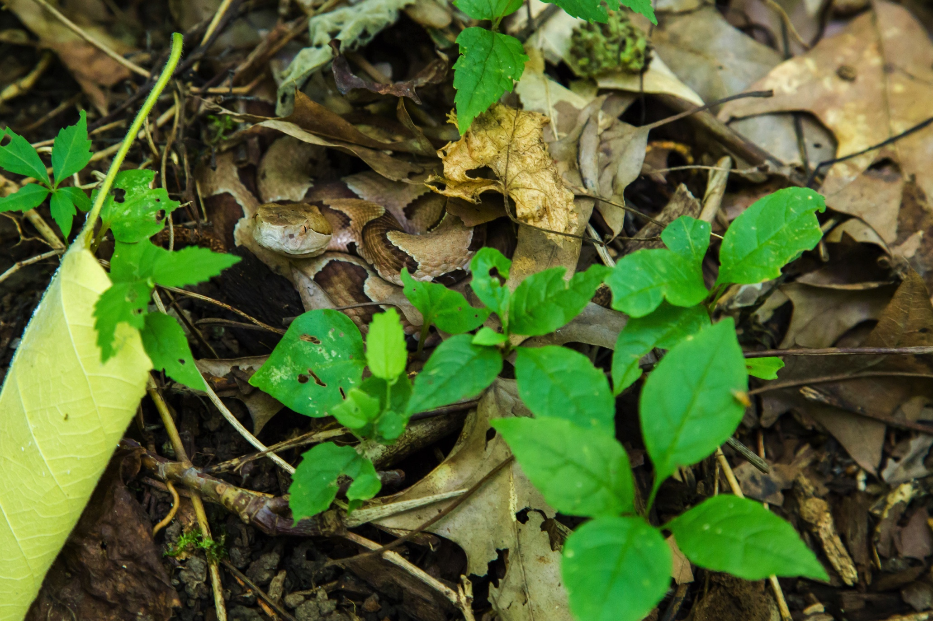
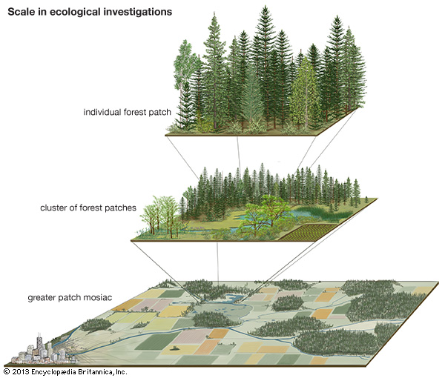
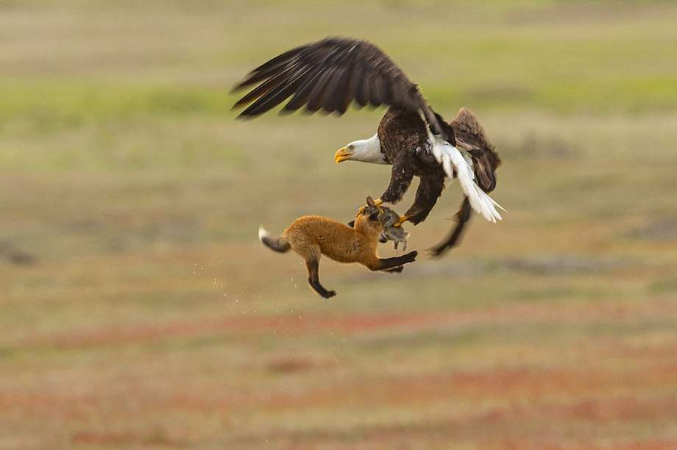
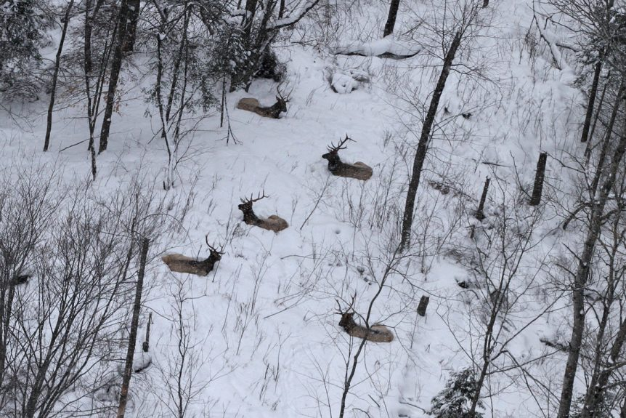
Most resource utilization (RUF) studies are conducted at the landscape scale.
Notes:
Currently, resource utilization studies have focused on landscape-level (macrohabitat) covariates. Microhabitat analyses are particularly important for small, limited mobility organisms such as snakes, that select for environmental parameters that cannot be measured remotely.

Slide 11
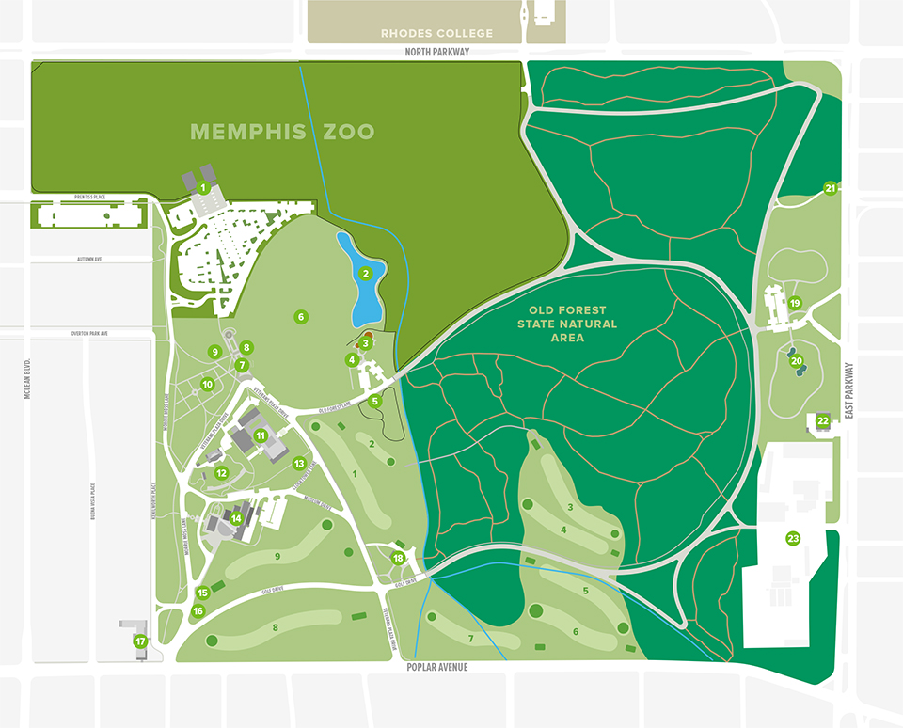
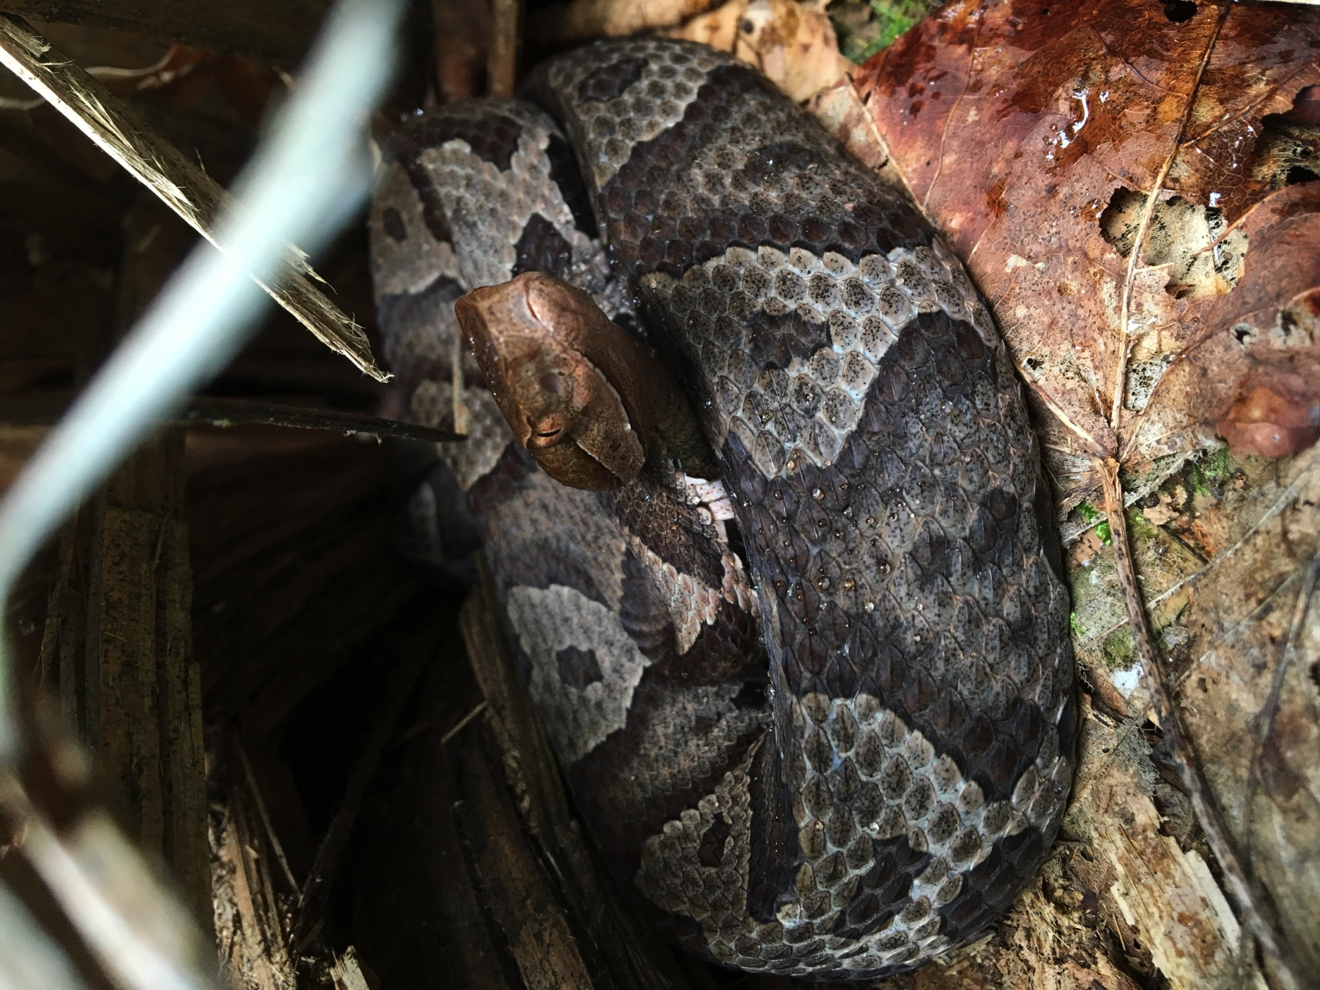
This study extends RUFs by using generalized estimating equations to model Use ~ Microhabitat covariates using a reptile model.
N. Prather
Notes:
GEEs have been previously applied to habitat analyses in resource selection (Koper & Manseau, 2009), but have not been currently applied in the resource utilization framework

Slide 12
Generalized estimating equations (GEEs)
Do not require a normal error dist in response variable
Specify correlation structure for dependency (i.e. within-subject) clusters
Robust standard errors if correlation misspecified
Ideal for longitudinal data with repeated measures.
t₁ t₂ t₃ t₄
t₁
t₂
t₃
t₄
Autoregressive correlation structure
(Zeger & Liang, 1986)

Slide 13
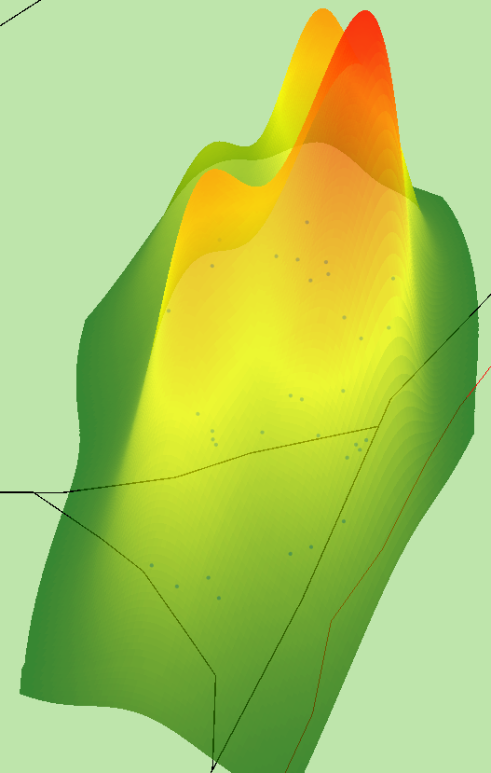
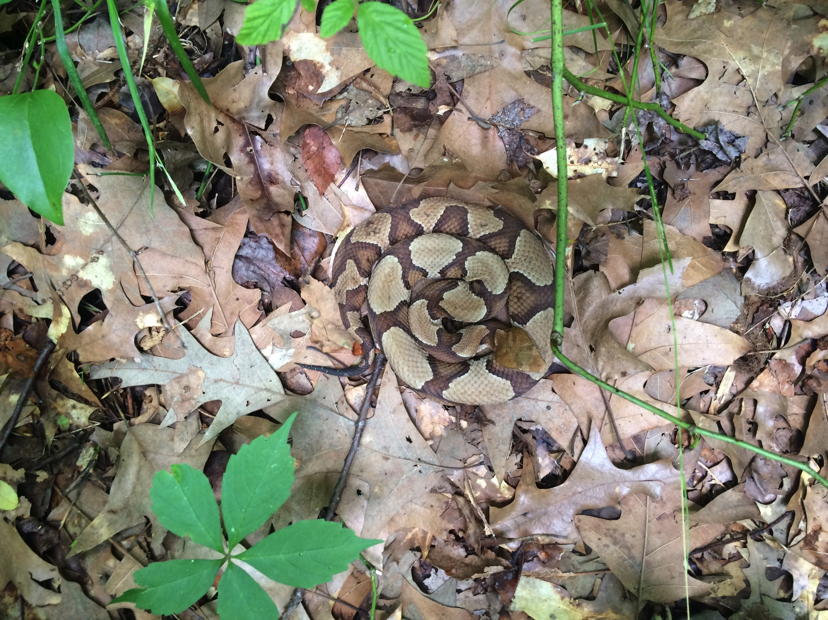
Low Use High Use
1 100
Y = f(X) + ε
Collect relocation habitat data
Create utilization distribution using point locations
Quantify resource use as height
Relate continuous use to habitat covariates

Slide 14
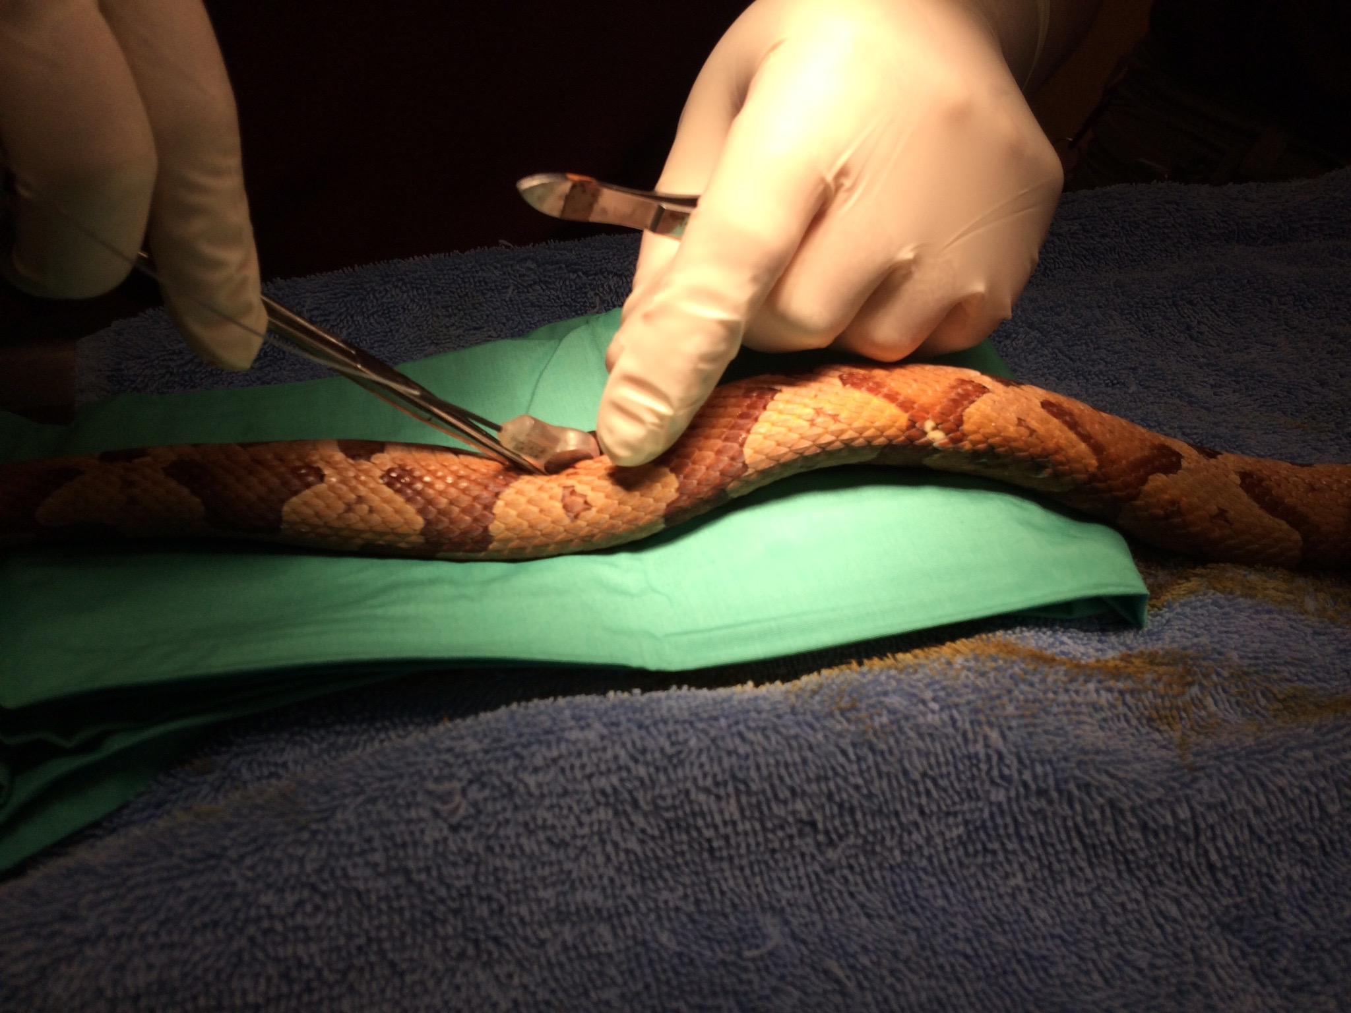
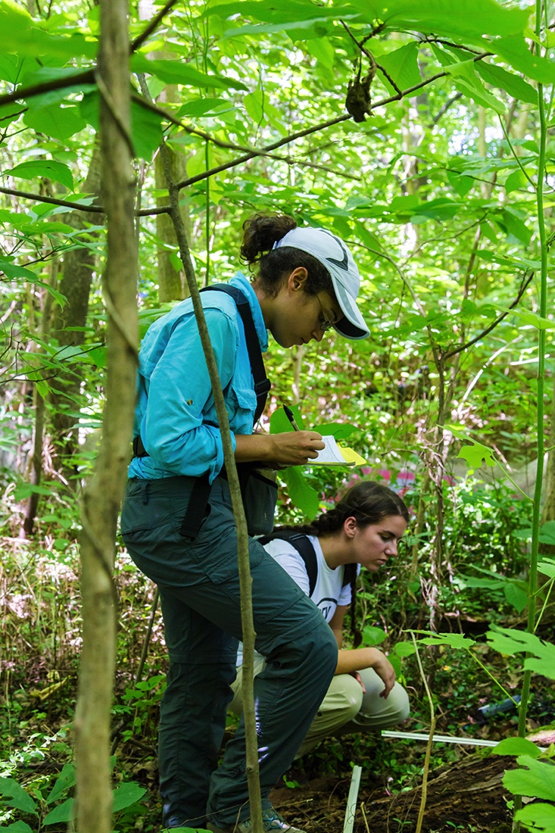
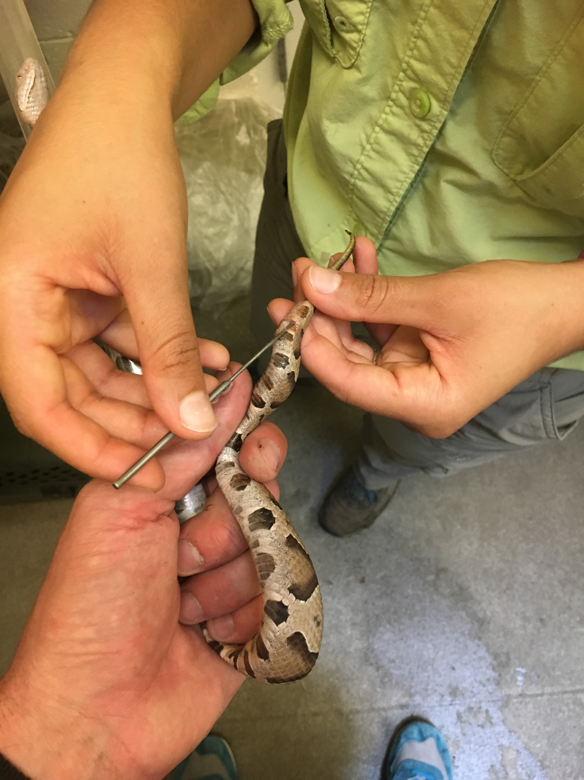

Slide 15
 | Code |  | Description
 | Environmental variables
Cover | DV | Dominant vegetation
 | TV% | Total living vegetation
 | C% | Canopy cover
 | LL | Leaf litter
 | LD | Leaf depth
 | WSD | Woody stem density
Log | LOG | Number of logs
 | DNL | Distance to log
 | DINL | Diameter of log
Tree | DNOV | Distance to overstory tree
 | DBHOV | Diamter of overstory trees
 | DNUN | Distance to understory tree
Collect relocation habitat data

Slide 16
Create utilization distribution using point locations
R: rhr (reproducible home ranges)
bivariate plug-in bandwidth
Notes:
Fixed-kernel home-range estimator

Slide 17
Create utilization distribution using point locations
R: rhr (reproducible home ranges)
bivariate plug-in bandwidth
Notes:
Fixed-kernel home-range estimator
Calculate kernel bandwidth
Calculate kernel density estimator
Create utilization distribution

Slide 18
Quantify resource use as height
Low Use High Use
1 100
R: adehabitatHR
Notes:
Calculate kernel bandwidth
Calculate kernel density estimator
Create utilization distribution
Get standardized volume of the 99% UD

Slide 19
Relate use to plot habitat covariates using generalized estimating equation
R: adehabitatHR/raster
Notes:
In landscape studies, they take every cell in a raster grid and relate it to habitat covariates.

Slide 20
Relate use to plot habitat covariates using generalized estimating equation
R: adehabitatHR/raster
Notes:
In my study, I do not have microhabitat covariates, so I related points to the cells within the grid that I do have.

Slide 21
DV
TV%
C%
LL%
LD
WSD
LOG
DNL
DINL
DNOV
DBHOV
DNUN
Sex
Day of Year
Relate use to plot habitat covariates using generalized estimating equation
Use ~
R: geepack

Slide 22
Low Use High Use
1 100
Y = f(X) + ε
Collect relocation habitat data
Create utilization distribution using point locations
Quantify resource use as height
Relate continuous use to habitat covariates

Slide 23
Complete model
Individuals: 21
Family: Gaussian
Link: identity
Coefficients | β(SE)
 | GEE | GLMM
dnl_1 | -3.34 (1.3) * | -3.72 (1.01)*
c | -0.11 (0.06) • | -0.11 (0.05)*
dvForb | -1.32 (6.44) | -3.21 (5.7)
dvGrass | 3.65 (8.49) | 3.28 (7.78)
dvIvy | -2.28 (6.34) | -2.47 (5.8)
dvSapling | -2.16 (6.89) | -7.94 (6.43)
dvShrub | 0.45 (6.17) | 2.33 (6.6)
dvThorns | 0.68 (8.71) | -7.16 (11.16)
dvTree | -1.13 (7.41) | -2.14 (6.24)
dvVines | 3.57 (6.11) | 4.52 (5.78)
log | 3.18 (1.52)* | 3.37 (1.05)*
dinl_1 | 0.09 (0.05) • | 0.1 (0.05)*
DOY | 0.04 (0.02) * | 0.04 (0.01)*
sexM | -2.19 (2.2) | -1.77 (1.93)
dnov | 0.5 (0.4) | 0.77 (0.46)•
ll | -0.04 (0.04) | -0.05 (0.03)
ld | 0.51 (0.45) | 0.28 (0.35)
dnun | 0.18 (0.46) | 0.81 (0.61)
dbhov | 0.01 (0.03) | 0 (0.03)
wsd | 0.2 (0.51) | 0.96 (0.54)•
tv | 0.05 (0.04) | 0.03 (0.03)
Correct
within-subject correlation
Incorrect
within-subject correlation
Autoregressive
AR1 Correlation α = 0.36 (0.04)
R: geepack; MASS
Notes:
Conditional models include GLMM and LM. GEE is a marginal model. Linear model provides similar estimates and smaller standard errors because doesn’t account for individual errors.
Things to note: autocorrelation feature in GEE. More conservative estimates.

Slide 24
Simplified model
Coefficients | β(SE)
 | GEE | GLMM
dnl_1 | -3.41 (1.05)* | -3.66 (0.92)*
c | -0.09 (0.05)• | -0.1 (0.04)*
log | 3.08 (1.33)* | 2.26 (0.91)*
dinl_1 | 0.04 (0.05) | 0.09 (0.04)*
DOY | 0.03 (0.02) | 0.03 (0.01)*
Incorrect
within-subject correlation
Correct
within-subject correlation
AR1 Correlation α = 0.41 (0.04)

Slide 25
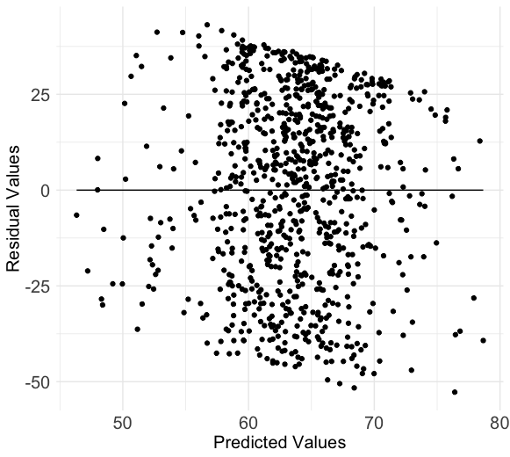
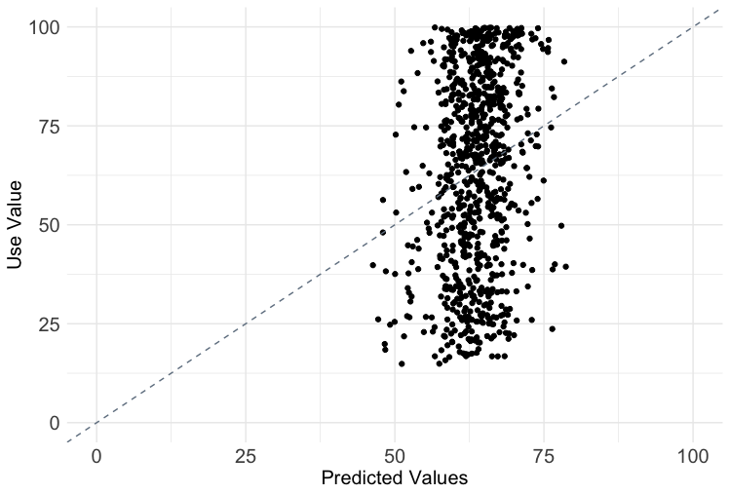
Model shows low predictive ability
Notes:
Homogeneity of variance issues…residuals are very wide and uneven across all predicted values. Also, large absolute values for residuals, indicating poor fit
If the model was better, we’d see a linear relationship between “Use” and “Predicted” values.

Slide 26
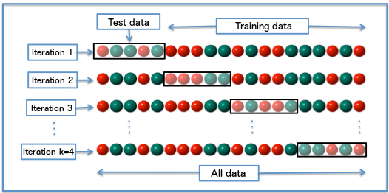
Cross validation shows little decrease in error compared to null model
Null model mean square error 577
Model mean square error:
564
564/577 = 0.977
Model does not perform much better than no habitat variables.

Slide 27
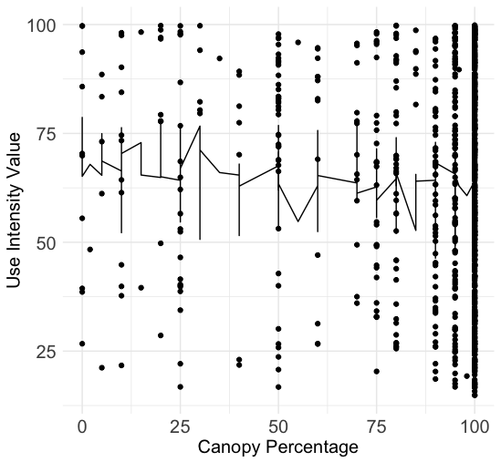
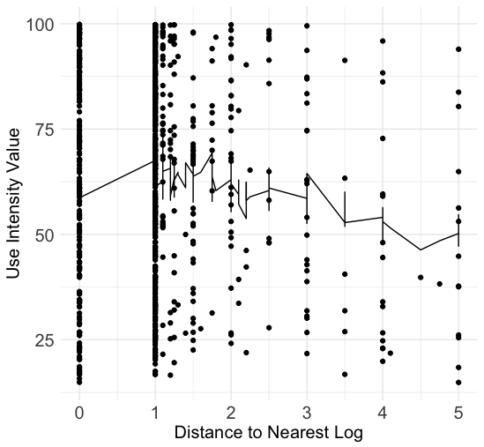
Noisy data

Slide 28
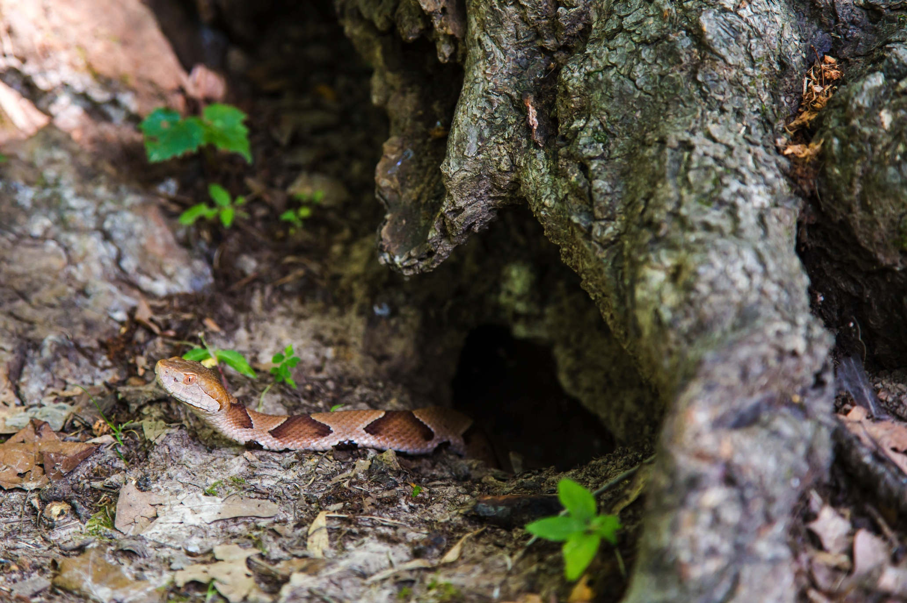
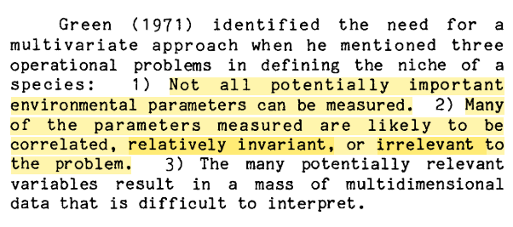
Modeling habitat use in Overton was not effective using habitat variables collected.
M. McMasters

Slide 29



Committee Members
Drs. Steve Reichling
Judy Cole
Mike Kennedy
Jennifer Mandel
Matthew Parris
Dr. Felicia Knightley, Senior Veterinarian, Memphis Zoo and vet staff
Zoo staff
Chris Baker
Lauren Caskey
Dori Colburn
Sara Hasenstab
Kristin Hinkson
Katherine Jay
Deanna Lance
Amy Misner
Beth Roberts
Bryan Summerford
Dr. Dale Bowman, U of M
Dr. Sarah Boyle, Rhodes College
Dr. Youngsang Kwon, U of M
Undergraduate assistants
Johneice Anderson
Mike Ballou
Ashley Bruneau
Kyle Fioranelli
Vaden Fite
Austyn Harriman
Houston Haws
Matthew Morrow
Megan Mosier
Betsy Minkler
Allie Swanson
Caleb Vickers
Triton Watkins
Arin Wildmann
Eric Bridges, Overton Park Conservancy
Jeremy Harris
Funding sources:
University of Memphis Biological Sciences
Conservation Action Network – Memphis Zoological Society
NSF
And a huge thanks to the snakes, too!
Tennessee Wildlife Resources Agency Permit 3851
IAUCC #15201

Slide 30
Modeling habitat use in Overton was not effective using habitat variables collected.
DV
TV%
C%
LL%
LD
WSD
LOG
DNL
DINL
DNOV
DBHOV
DNUN
Sex
Day of Year
Use ~

